Slide 1
Next.js Performance Boost: Middleware, Caching & Optimization

Slide 2
Agenda
Introduction to Performance Optimization in Next.js
Middleware in Next.js
Caching Strategies in Next.js
Optimization Techniques in Next.js

Slide 3
Introduction to Performance Optimization in Next.js
Why Performance Matters:
Improves load times & user experience (UX)
Boosts SEO rankings
Enhances API responsiveness
Key Performance Factors:
Load Time: Critical for user retention
SEO: Faster sites rank better
API Response: Better interactivity & engagement
User Experience (UX): Smooth navigation increases conversions

Slide 4
Middleware in Next.js
What is Middleware?
Middleware in Next.js is code that runs before a request reaches your page or API route. It provides a centralized way to handle tasks such as authentication, redirection, logging, and more.
Next.js Implementation:
Defined using middleware.ts or middleware.js
Executes on both development and production environments
Benefits:
Centralized request handling
Pre-processing requests for security, routing, and more

Slide 5
Middleware Use Cases & Examples
Authentication & Authorization:
Protect routes using JWT-based authentication
Redirections & Rewrites:
Conditional redirection based on user location or preferences
Logging & Analytics:
Track page visits and log user activity for insights
Rate Limiting & Security:
Throttle API calls to prevent abuse

Slide 6
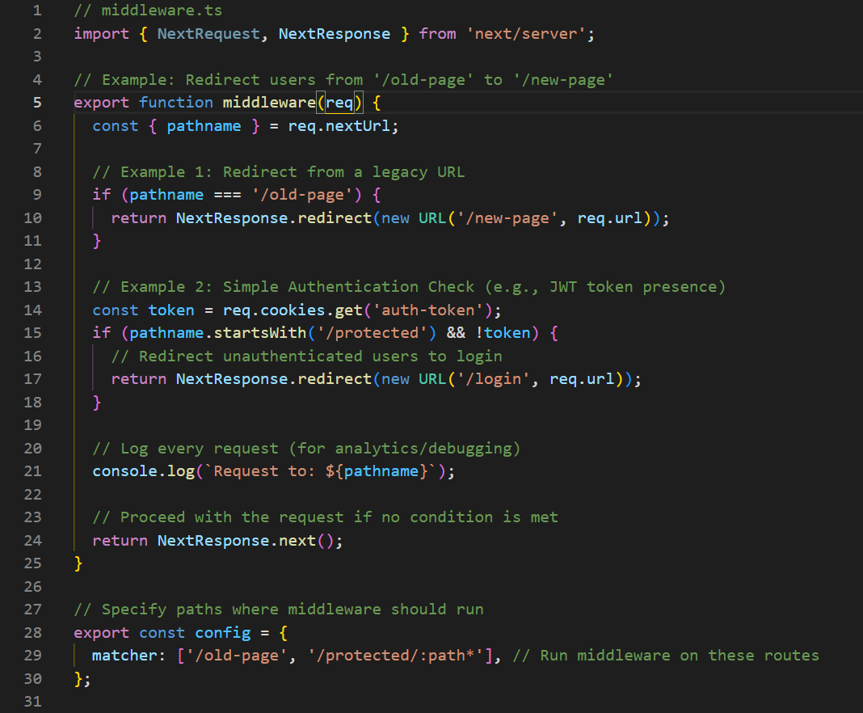

Slide 7
Caching Strategies in Next.js
Why Caching?
Reduces server load and improves response times
Caching Types:
Static Site Generation (SSG) & Incremental Static Regeneration (ISR):
Pages are pre-rendered at build time, and ISR allows them to update periodically.
Server-side Caching:
Use getServerSideProps to set cache headers and cache API responses.
Client-side Caching:
Use libraries like SWR or React Query to cache data fetched on the client.

Slide 8
Optimization Techniques in Next.js
Image Optimization
Next.js provides an <Image> component that automatically optimizes images, supports lazy loading, and generates multiple sizes.
Benefits:
Reduced bandwidth usage
Improved page load times
Example:
Using the next/image Component

Slide 9
Optimization Techniques in Next.js
Code Splitting & Lazy Loading
Next.js automatically performs code splitting. For dynamic imports—especially for heavy components—you can use next/dynamic to lazy load them.
Benefits:
Faster initial load and improved performance metrics
Example:
Dynamic Import in TypeScript

Slide 10
Optimization Techniques in Next.js
Preloading & Prefetching
Next.js’s <Link> component supports prefetching of pages, meaning linked pages can be loaded in the background for instant navigation.
Benefits:
Near-instant page navigation
Smoother user experience
Example:
Prefetching with next/link

Slide 11
Optimization Techniques in Next.js
Reducing JavaScript Size
Tree Shaking: Ensure you import only the necessary parts of libraries. Remove unused dependencies
Minification: Next.js automatically minifies JavaScript & CSS in production builds.
Bundle Analysis: Use tools like next-bundle-analyzer to identify and remove unused code in next.config.js file.

Slide 12
Let’s Talk!
Thank You!
Prashant Solanki
prashant.s@tridhyatech.com
www.tridhyatech.com

