Slide 1
G H PATEL COLLEGE OF ENGINEERING & TECHNOLOGY
(A Constituent College of CVM University)
DEPARTMENT OF COMPUTER ENGINEERING
“Diabetes Prediction”
Internal Guide:
Prof. Khyati Mehta
Prepared by:
Prashant Solanki (190110107068)

Slide 2
Abstract
Diabetes disease is the most common disease worldwide and keeps increasing everyday due to changing
Lifestyles, unhealthy food habits and over weight problems.
There were studies handled in predicting diabetes disease through physical and chemical tests, are
available for diagnosing diabetes.
Data science methods have the potential to benefit other scientific fields by shedding new light on
common questions.
With the help of machine learning, we used K- Nearest Neighbour and classification (Support Vector Machine)
algorithm.
The experiment results shows that the prediction of diabetes done at high accuracy.

Slide 3
Flowchart of Process :
Performance evaluation on various measures
Dataset
Preprocess
Data
Applied
Algorithms
Comparative analysis
based on accuracy
Results

Slide 4
Dataset
The dataset used is the “PimaIndiansDiabetes.csv ”
There are total 9 attributes in the dataset.
Glucose 2) Pregnancies 3) Blood Pressure 4) Skin Thickness 5) Insulin
6) BMI 7) Diabetes Pedigree Function 8) Age 9) Outcome

Slide 5
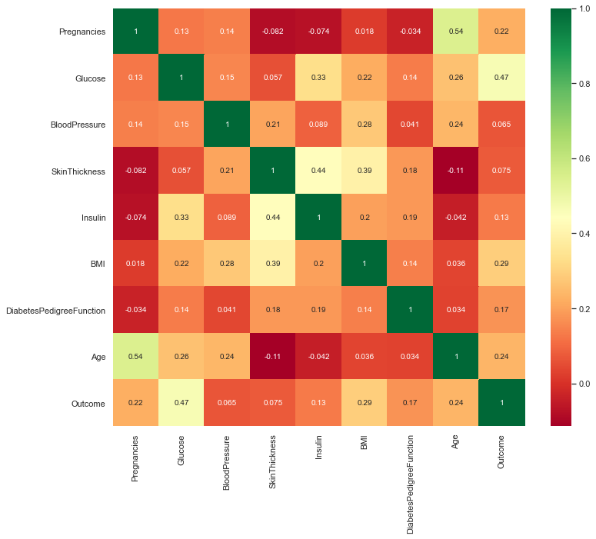
Correlation Matrix
It is easy to see that there is no single feature that has a very high correlation with our outcome value. Some of the features have a negative correlation with the outcome value and some have positive.

Slide 6
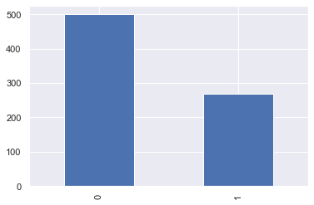
Bar Plot For Outcome Class
The above graph shows that the data is biased towards datapoints having outcome value as 0 where it means that diabetes was not present actually. The number of non-diabetics is almost twice the number of diabetic patients.

Slide 7
k-Nearest Neighbour Algorithm
The k-NN algorithm is arguably the simplest machine learning algorithm. Building the model consists only of storing the training data set. To make a prediction for a new data point, the algorithm finds the closest data points in the training data set, its “nearest neighbors.”

Slide 8
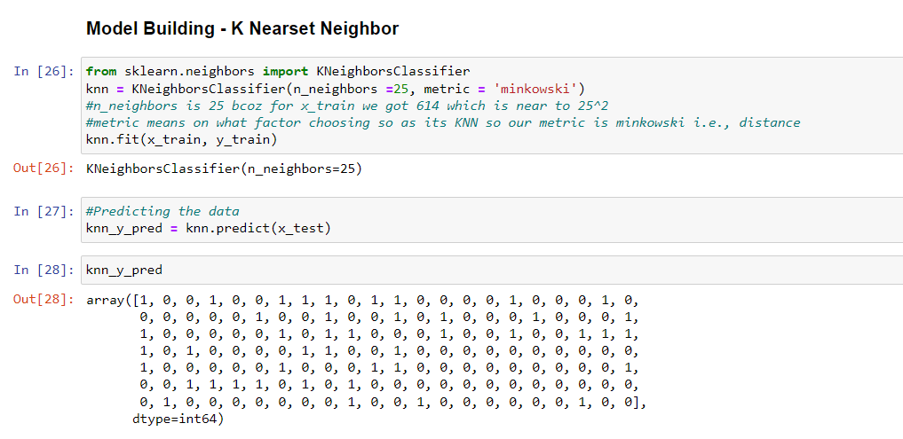

Slide 9
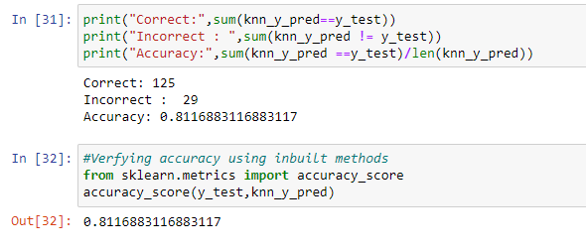
The accuracy of K – Nearest Neighbour algorithm is proved to be 78% - 82% .

Slide 10
Support Vector Machine :
Support Vector Machine or SVM is one of the most popular Supervised Learning algorithms, which is used for Classification as well as Regression problems. However, primarily, it is used for Classification problems in Machine Learning.
The goal of the SVM algorithm is to create the best line or decision boundary that can segregate n-dimensional space into classes so that we can easily put the new data point in the correct category in the future. This best decision boundary is called a hyperplane.
This classifier aims at forming a hyper plane that can separate the classes as much as possible by adjusting the distance between the data points and the hyper plane. There are several kernels based on which the hyper plane is decided.

Slide 11
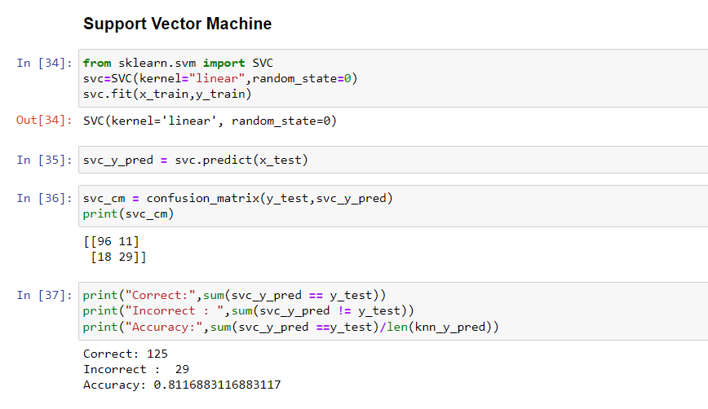

Slide 12
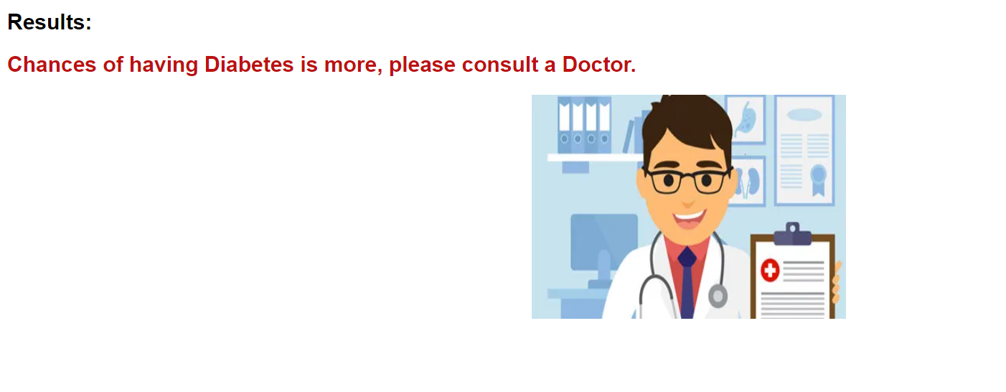
Application :
Output :

Slide 13
Conclusion
The main aim of this project was to design and implement Diabetes Prediction Using Machine Learning Methods and Performance Analysis of that methods and it has been achieved successfully. The proposed approach uses various classification and ensemble learning method in which SVM, Knn, Random Forest, Decision Tree, Logistic Regression and Gradient Boosting classifiers are used. And 81.16% classification accuracy has been achieved in K-Nearest Neighbour. The Experimental results can be asst health care to take early prediction and make early decision to cure diabetes and save humans life.

