Slide 1
Angular 17
Mukund Dholariya

Slide 2
Conditional Statements
Built-in for loop
Control-flow migration
Deferrable Views
Hydration
Signals

Slide 3
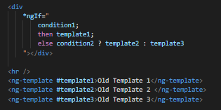
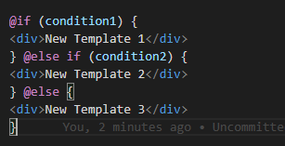
Conditional statements
Replaced *ngIf directives with new syntax @if, @else if, and @else for conditional block
Before angular 17 update
After angular 17 update
Proposal

Slide 4
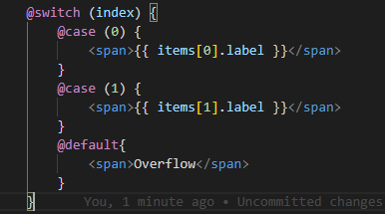
Conditional statements
Replaced *ngSwitch, *ngSwitchCase directives with new syntax @switch, @case for conditional block
Before angular 17 update
After angular 17 update
Proposal

Slide 5
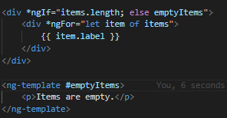
Built-in for loop
Replaced *ngFor directives with new syntax @for for iteration over lists
Before angular 17 update
After angular 17 update
Proposal

Slide 6
Control-flow migration
In angular 17 - cli provide command for to convert old control-flow syntax to new control-flow syntax
ng generate @angular/core:control-flow
After apply above command ngIf, ngFor and ngSwitch syntax change to @if, @for and @switch syntax
Proposal

Slide 7
Deferrable Views
@defer is an Angular template syntax, that allows you to load parts of a template only when they are needed, given a logical condition.
The @defer syntax allows us to implement common use cases such as:
only load a large component after the user scrolls down the page after a certain point
only load a large component after the user clicks on a button
preload a large component on the background while the user is reading the page, so that it is ready by the time the user clicks on a button
Proposal

Slide 8
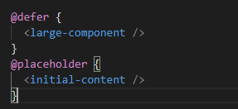
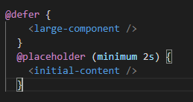
@defer with @placeholder
We want to display some initial content to the user, that will later be replaced by the code loaded via the @defer block.
We can do that by wrapping the initial content that we want to display in a @placeholder block.
The @placeholder block can take one optional parameter called minimum, which is a time duration in seconds or milliseconds.
Proposal

Slide 9
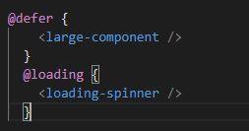
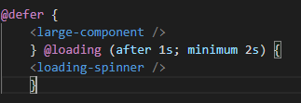
@defer with @loading
The @loading block is used to show some content while the @defer block is still loading its JavaScript bundle in the background.
The @loading block accepts two optional parameters: minimum and after: , minimum is used to specify the minimum amount of time that the @loading block will be shown to the user. after is used to specify the amount of time we should wait before showing the @loading indicator after the loading process is started.
Proposal

Slide 10
@placeholder vs @loading
@placeholder
Displayed initially: This block is shown before the deferred content even starts loading.
Minimum duration: You can specify an optional minimum time for which the @placeholder should be shown, even if loading finishes faster.
@loading
Displayed during loading: This block only appears after the loading of the deferred content has started and continues until it finishes.
Delay options: You can specify an optional minimum time for showing the @loading block after loading begins, and also a minimum total duration for its display.
Proposal

Slide 11
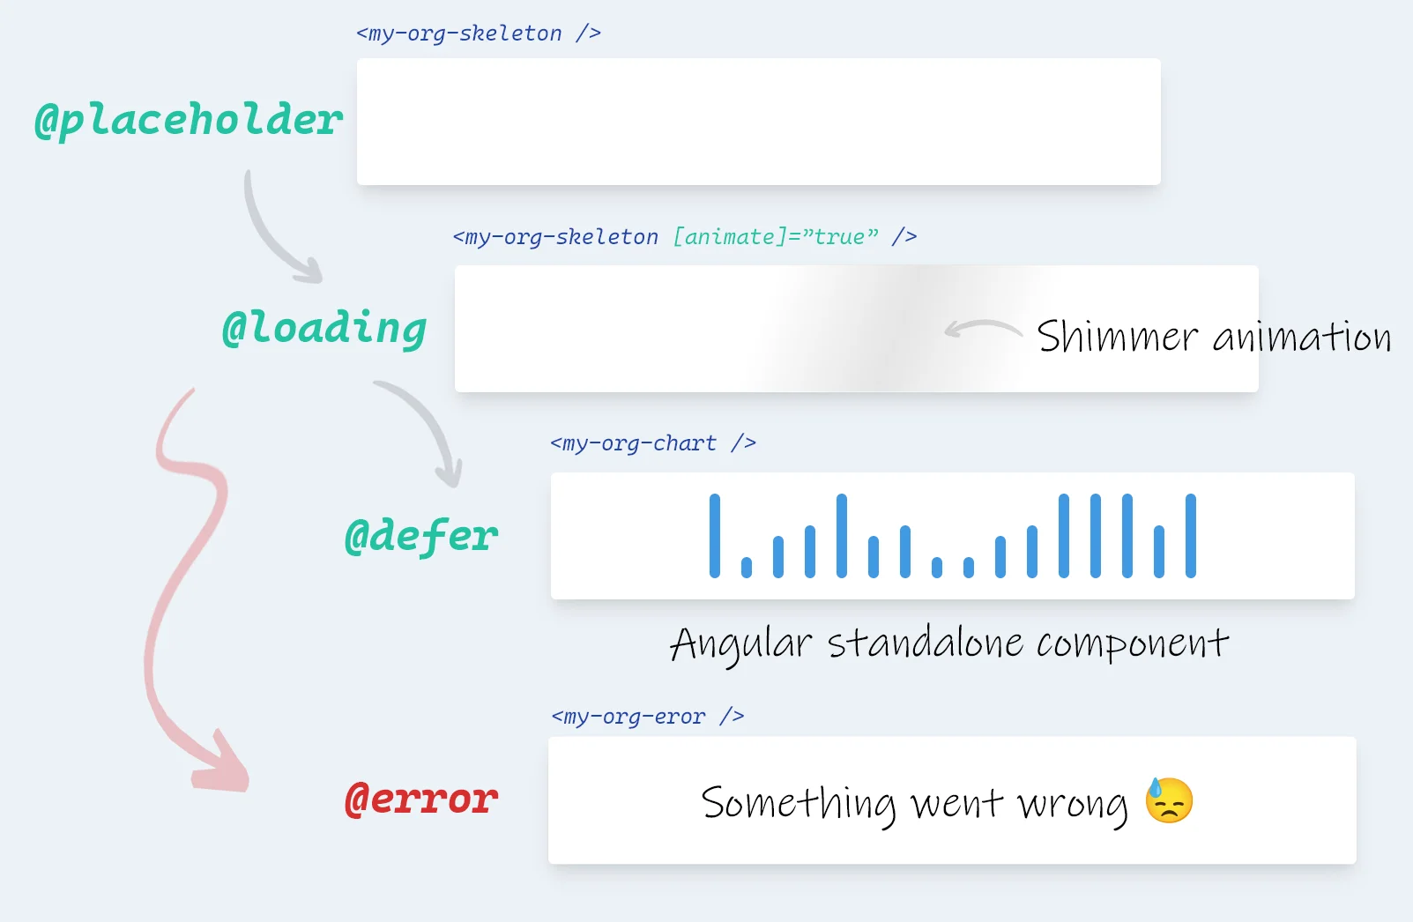
@placeholder vs @loading
Proposal

Slide 12
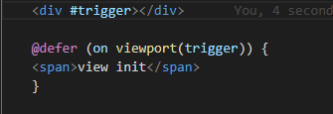
@defer with on viewport
With this strategy, the page will render first the content above the fold, which is immediately visible to the user once the page is loaded.
The rest of the content will be loaded only when and if the user scrolls down the page.
This way, the initial page will load faster, and we avoid loading code that the user might never see.
Proposal

Slide 13
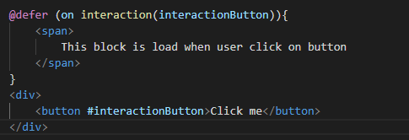
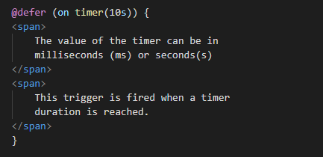
@defer other option
Defer with interaction
Defer with timer
Defer with hover
Proposal

Slide 14
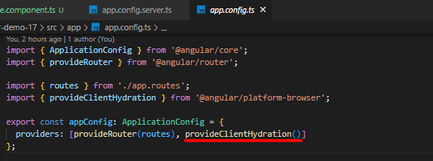
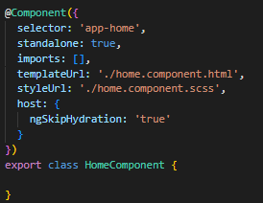
Hydration
Hydration is the process that restores the server side rendered application on the client. This includes things like reusing the server rendered DOM structures, persisting the application state, transferring application data that was retrieved already by the server, and other processes.
Some components may not work properly with hydration enabled due to some of the issues, like Direct DOM Manipulation.
Proposal

Slide 15
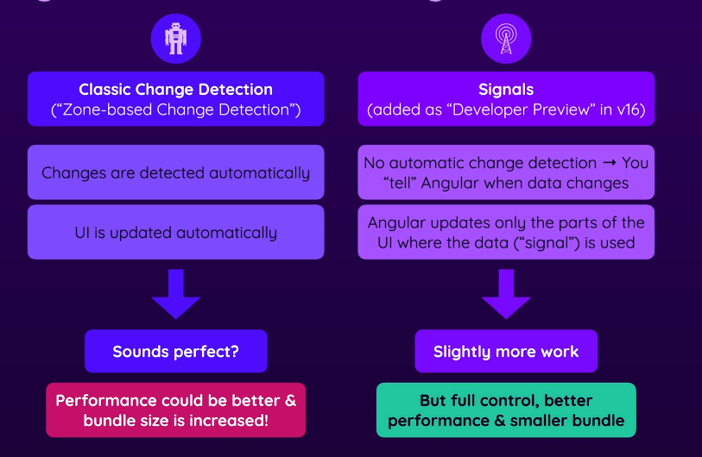
What is Signals
Proposal

Slide 16
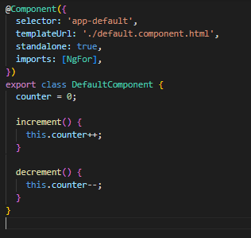
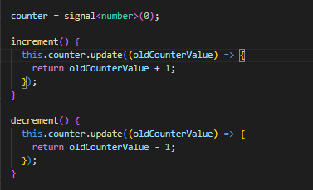
Signals Example
Without using Signals
Using Signals
Proposal

Slide 17
Any Questions?
Proposal

Slide 18
Thank you
Proposal

